Slide 1
Brief introduction to (short) read sequence analysis using RNA-Seq as an example

Slide 2
Aside: Single v Paired end sequencing
Application | Single or Paired End Seq? | Considerations?
SNP Detection | Either | Higher Coverage - better
INDEL detection | Paired-End | Need structural information
Structural Variation Detection | Paired-End | Need structural information
Genome Assembly | Paired-End | Need structural information
RNA Seq | Either | Depends heavily on use-case
Notes:
For RNA-seq
If you’re working with small RNA SE is fine
Capture insert well with Seq

Slide 3
Sequencing as a readout or as a discovery tool
Sequencing as a readout
Sequencing as discovery
Sequencing has become a standard way to measure the output of an assay genome wide:
Transcriptional output
Protein occupancy
Variant calling
Usually done using short read in what we call counting applications
Sequencing was originally used to discover or annotate:
Genome sequencing
Gene annotation
Usually done using libraries of large inserts, longer reads
Lately with mixed technologies

Slide 4
Experimental design is crucial to achieve your goal
Transcriptomics
Just gene expression?
Splicing and isoform quantification?
Discovery?

Slide 5
Experimental design is crucial to achieve your goal
Transcriptomics
Just gene expression?
Large number of samples – 3 or 5 enrichment methods low depth
Smaller number of samples – full length, paired end reads
Splicing and isoform quantification?
Increased depth -- 20 million paired reds
Mixed with long reads
Discovery?
Mixed samples use for denovo assembly
Mix long read sequencing for scaffolding

Slide 6
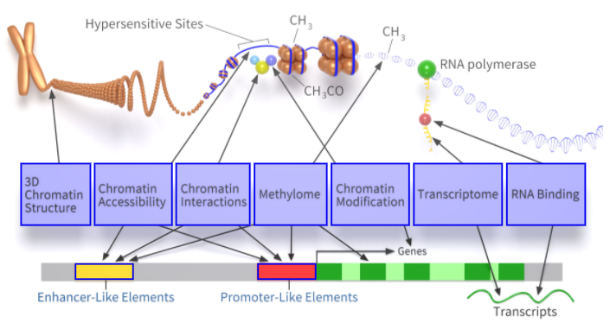
“Functional” DNA sequencing protocols
Notes:
Remake for specific types of sequencing

Slide 7
“Functional” RNA protocols
mRNA
lncRNAs
rRNAs
Small RNAs
(miRNA, tRNA, piRNA, snRNA, …)
RNA structure
RNA binding protein interactions
“CLIP-seq”
Translating RNA (ribosome-associated)
“Ribo-seq”
Notes:
Remake for specific types of sequencing

Slide 8
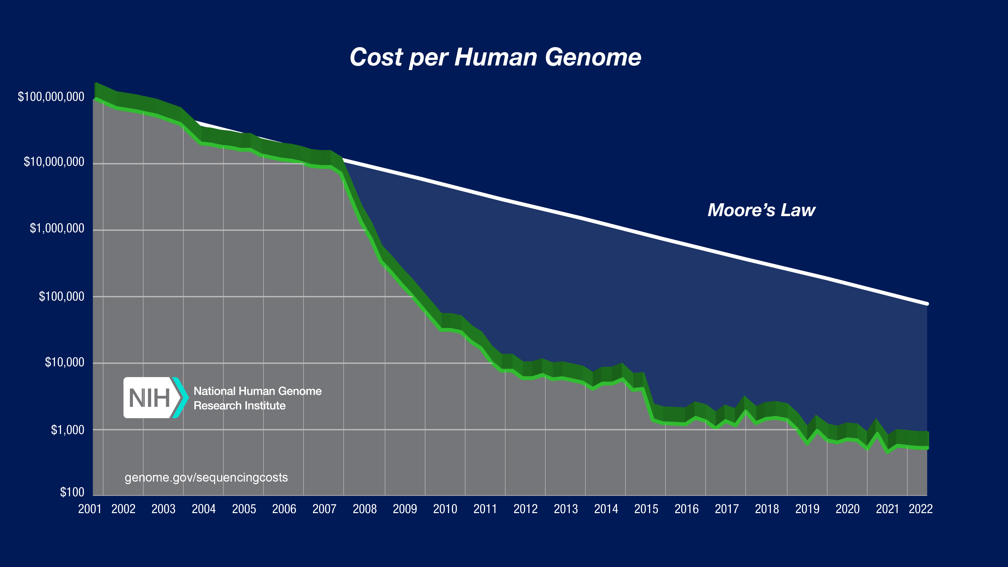
Sequence costs have stabilized – sequence analysis is maturing
Most applications are counting applications

Slide 9
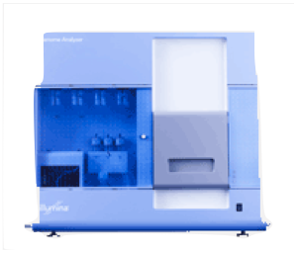

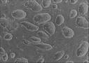
Measuring gene expression by sequencing
sequencer
Sequenced reads
cells
(c)DNA
Alignment
read coverage
genome

Slide 10
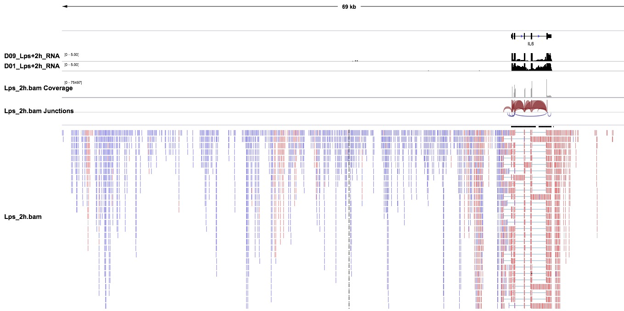
And (RNA) sequence data looks like this

Slide 11
… or like this
Notes:
Remember … Kendal Tau =[ (# concordant pairs) – (# non concordant)]/n(n-1)/2
Recall: Use R for the example.

Slide 12
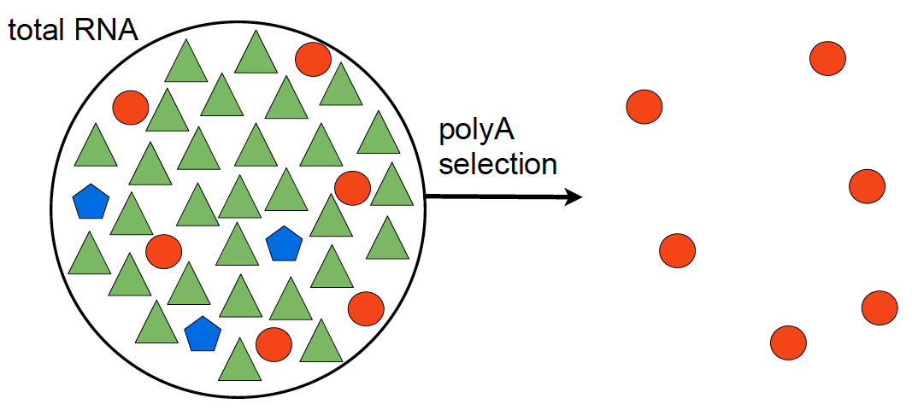
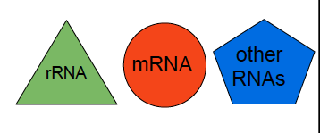
Many ways to get there – Library Preparation

Slide 13
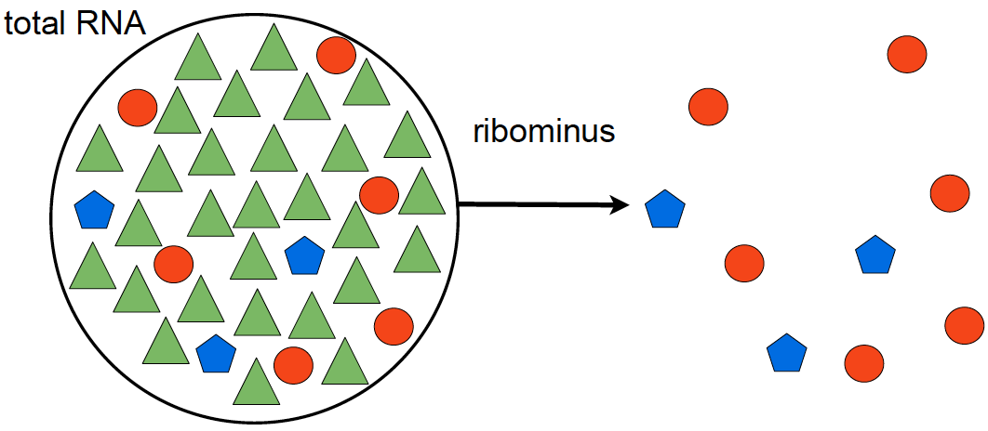
Library Preparation – removing unwanted species
polyA selection
ribominus selection
poly(A+)-transcripts:
mRNAs
immature microRNAs
snoRNAs
non poly(A+)-transcripts:
mRNAs
histone mRNAs
tRNAs
other small RNAs
Notes:
snoRNAs (synthesized by RNA polymerase II).
histone mRNAs (generated by RNA polymerase II)
small RNAs generated by RNA polymerase III

Slide 14
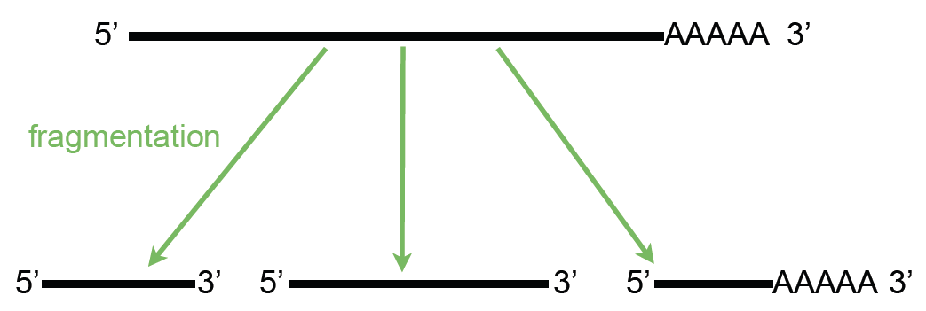
Library Preparation -- fragmentation

Slide 15
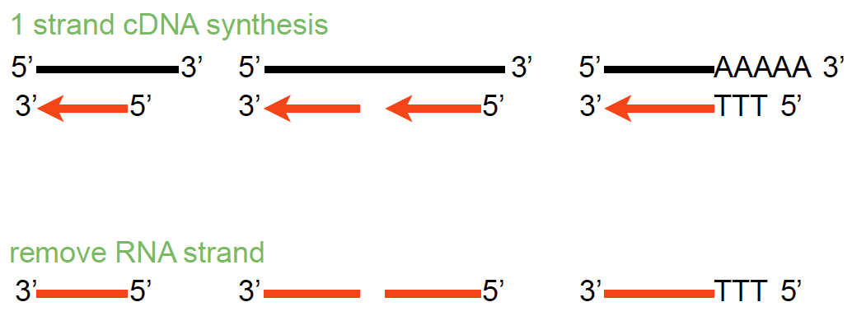
Library Preparation – Making cDNA

Slide 16
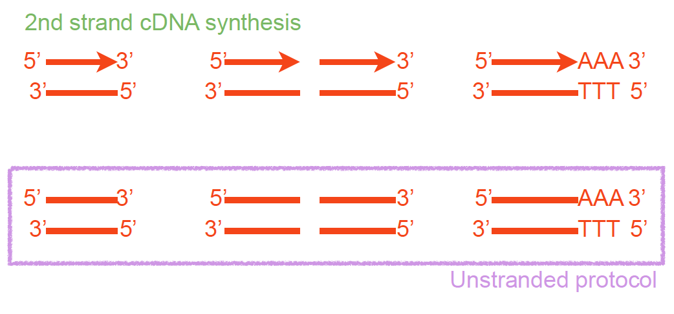
Library Preparation – Unstranded vs Stranded

Slide 17
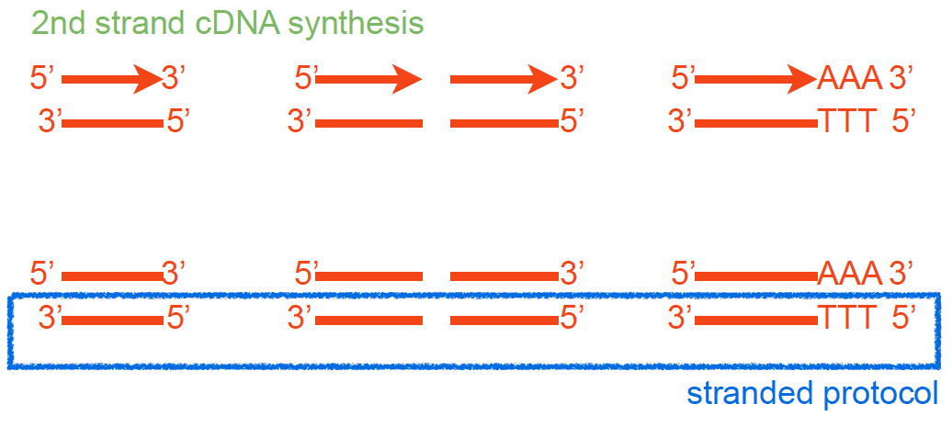
Library Preparation – Strand specific
Parkhomchuk, D., et al. (2009), Nucleic Acids Res, 37 (18), e123.

Slide 18
Library Preparation – Final steps have consequences
Fragmented cDNA
cDNA with adaptors
Size selection
PCR amplification
Notes:
Popy T magnetic beads used for polyA selection
RNA Mg and heat ; alkaline hydrolysis or nebulization) hydrojet - 200 – 500bp and cDNA fragmentation (DNase I treatment or sonication).
End repair after RT, addd A, adaptor ( contain seq compliment to the oligo in the flowcells and seq primer site)

Slide 19
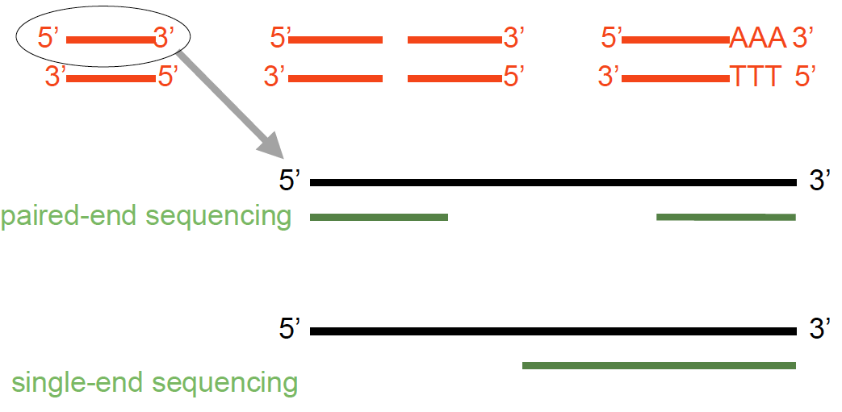
Sequencing a Library – paired vs single end

Slide 20
Single- vs paired-end sequencing
my_sequence.fastq
@HWI-BRUNOP16X_0001:1:1:1466:1018#0/1
AAGGAAGTGCTTGTCTGGCTAACACAGCNAGNCACGTGAC
+
aVfbe`^^^_TTTSSdffffdfffabbZbbfebafbbbbb
SE
my_sequence_1.fastq
@HWI-BRUNOP16X_0001:1:1:1278:989#0/1
NAAATTTCGAATTTCTGTGAAGTAAGCATCTTCTTTGTCAT
+
BJJGGKIINN^^^^^QQNTUQOOTTTRTOTY^^Y^\\^^^\
PE
my_sequence_2.fastq
@HWI-BRUNOP16X_0001:1:1:1278:989#0/2
AACCCACACAGGAGAGCAGCCTTACAGATGCAAATACTGTG
+
]K___fffffggghgeggggggdgggggfgggggegggghh
Notes:
Now it’s important to distinguish between SE and PE data
SE data is generated just as we described
The main difference with PE is that here we are using two different adaptors
And we are sequencing the molecule from both ends (and we know which end is)
This has the main advatage that we can obtain more information without having to sequence longer reads
For RNA-seq though PE data provides more information: splicing events
Also, for DNA-seq, SVs
In terms of output, different fastq files
Read names
Although the pipeline is the same, we’ll probably have to hange some options in the software we execute, as we’ll see

Slide 21
Having enough data (reads)
COVERAGE: How many reads do we need?
The coverage is defined as C = ( R_{length} x R_{num} ) / A_{length}
R_{length} = length in nucleotides of the reads
R_{num} = number of sequenced reads
A_{length} = number of nucleotides of sequenced subject (genome, transcriptome, exome)
The amount of sequencing needed for a given sample is determined by the goals of the experiment and the nature of the RNA sample.
Sims et al. Nature Reviews Genetics 15, 121–132 (2014)

Slide 22
From reads to gene expression

Slide 23
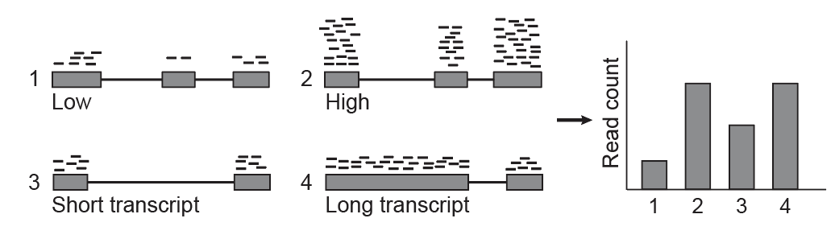
Larger transcripts generate more reads
Garber et. Al. Nat. Methods 2011

Slide 24
We need to normalize
RNA-Seq read output depends on:
Transcript expression level in the cell/tissue
Transcript length
Depth of sequencing
Can’t compare between genes or across samples

Slide 25
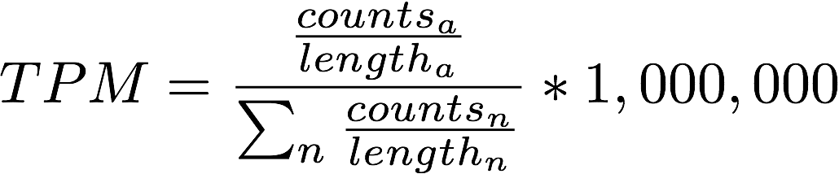
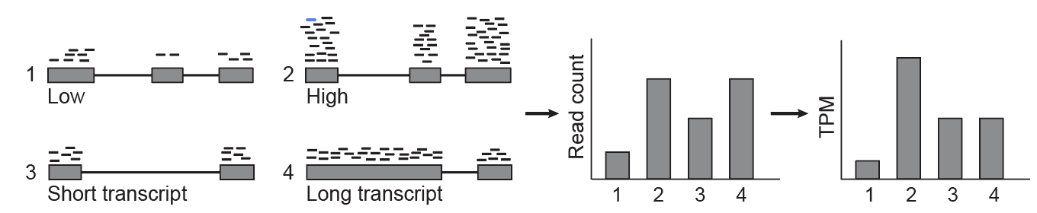
Transcripts per million (TPM) normalization
Transcripts per Million
Transcript length
Library sequencing depth
 | counts |  | TPM
sample | ctrl | exp | ctrl | exp
Fgf21 | 173 | 332 | 27097.5 | 76362.5

Slide 26
Properties of TPM
The sum of all TPMs is the same for all samples
Accounts for differences in sample sequencing depth
Accounts for gene length differences.
if TPM_{g1} > TPM_{g2} then g₁ is more highly expressed than g₂

Slide 27
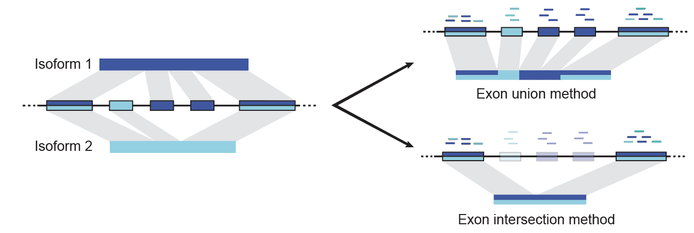
What counts?, What Length?
How do we define the length of a gene?
Can we estimate the expression of each isoform?
Solution: Estimate the expression of each isoform and use an effective gene length that weighs the length contribution of each isoform
Garber et. Al. Nat. Methods 2011

Slide 28
Wait! – Isoforms share exons!
Problem: Multimapping reads
Since isoforms share exons, many reads map to more than one isoform
Genes with close paralogs generate reads that may not map uniquely
Solution: Probabilistic read assignment
Use unique reads to estimate a prior of isoform proportions and assign reads proportionally
In general: Use any available feature to assign reads uniquely!

Slide 29
Example: Use fragment sizes in paired libraries
P₁
P₂
Get all single isoform reconstructions
Splice and compute insert distance
d₁
d₂
Estimate insert size empirical distribution

Slide 30
The gene expression table
Genes are quantified. Each gene or isoform has:
A TPM value
A (expected) fragment count vaue
All samples were quantified in the same fashion and arranged into a table of genes (22,000) x samples (24).
Row i gives the expression of the gene i across all samples
Row j gives the expression of genes in sample j.
gene | L^{Δ1,2}.rep1 | L^{Δ1,2}.rep2 | L^{Δ1,2}.rep3 | L^{Δ1.}rep1 | L^{Δ1}.rep2 | L^{Δ1}.rep3 | L^{Δ2}.rep1 | L^{Δ2}.rep2 | L^{Δ2}.rep3
Mir301 | 0 | 0 | 0 | 0 | 0 | 0 | 0 | 0 | 0
Cpne2 | 157 | 158.98 | 88.04 | 69 | 111.99 | 114.33 | 93 | 208 | 140
Capn5 | 36 | 65 | 46 | 46 | 69 | 42 | 33 | 58 | 59.01
Lage3 | 313.06 | 241.23 | 276.23 | 218.9 | 285.19 | 359.65 | 269.7 | 359.04 | 417.47
Brd7 | 379 | 358.58 | 390 | 336 | 357.26 | 368.08 | 264 | 564.07 | 476
Dimt1 | 77 | 68 | 58 | 54 | 62 | 60 | 54 | 76 | 97.03
AK017068 | 0 | 0 | 0 | 0 | 0 | 0 | 0 | 0 | 0

Slide 31
Q1: Who is expressed?

Slide 32
Q1: Who is expressed?

Slide 33
Q1: Who is expressed?
~10,000 genes

Slide 34
Exploratory analysis – Clustering and PCA
Matrices are too large, takes too much compute power:
Initial 25,000 x 24 = 500,000 entries
Filtering reduces by half: 250,000 entries
We can focus on interesting genes. Which ones?
Genes that vary most are most informative, how do we find them?
Variance or standard deviation
Coefficient of variance: sd/mean!

Slide 35
An example from yesterday

Slide 37
References and thanks to
Slides: Elisa Donnard, Athma Pai, Aaron Quinlan / Cartoons: BioRender, EMBL-EBI
https://michelebusby.tumblr.com/post/26913184737/thinking-about-designing-rna-seq-experiments-to ← Designing RNA-Seq experiments
RNA-seq workflow: gene-level exploratory analysis and differential expression https://bioconductor.org/packages/release/workflows/vignettes/rnaseqGene/inst/doc/rnaseqGene.html ← Tutorial with examples
Anders S, Huber W. Differential expression analysis for sequence count data. Genome Biol. 2010;11(10):R106. https://doi:10.1186/gb-2010-11-10-r106 ← DESeq
https://www.bioconductor.org/packages/release/bioc/vignettes/edgeR/inst/doc/edgeRUsersGuide.pdf ← edgeR user guide
Bo Li, Victor Ruotti, Ron M. Stewart, James A. Thomson, Colin N. Dewey, RNA-Seq gene expression estimation with read mapping uncertainty, Bioinformatics, Volume 26, Issue 4, 15 February 2010, Pages 493–500, https://doi.org/10.1093/bioinformatics/btp692

